Slide 1
Service Quality
Chapter 10

Slide 2
Service Quality
Measuring and improving quality is more difficult for services than for products
  Unsatisfactory service cannot be replaced or repaired
  Intangible and temporary nature

Slide 3
Quality Systems
Total Quality Management (TQM)
  Managing the entire organization so that it excels on all dimensions of products and services that are important to the customer
  Drivers are often set internally
Return on Quality (ROQ)
  Customers set parameters and marketers select quality improvements that lead to the highest return on investment

Slide 4
Defining Service Quality
Specifications
  Company: Standard operating procedures
  Customer: Personal expectations
  Misalignment of company and customer specifications can lead to dissatisfaction, even if the service is delivered as designed
    Effective communication is key in eliminating misalignment

Slide 5
Defining Expectations
Will expectation: Average level of quality that is predicted based on all known information
Should expectation: What customers feel they deserve from the transaction
Ideal expectation: What would happen under the best of circumstances; useful as a barometer of excellence
Minimally acceptable level: The threshold at which mere satisfaction is achieved

Slide 6
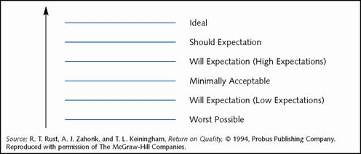
The Expectations Hierarchy

Slide 7
Types of Definitions of Quality
Transcendent: Innate excellence that can be recognized only through experience
Product-based: Measurable quantities are used to define quality
User-based: “Quality is in the eyes of the beholder”
Manufacturing-based: Conformance to requirements
Value-based: A balance between conformance or performance quality and an acceptable price to the customer

Slide 8
Measuring Service Quality
Reliability: Consistency of performance and dependability
Responsiveness: The willingness or readiness of employees to provide service.
Assurance: The knowledge, competence and courtesy of service employees and their ability to convey trust and confidence
Empathy: The caring and individual attention provided to customers
Tangibles: Physical evidence of the service

Slide 9
SERVQUAL Model
Compares customer expectations with their experience of the service that was actually delivered
  Discrepancies are “gaps” in service quality

Slide 10
SERVQUAL Model
Word-of-Mouth
Communications
Personal Needs
Past Experience
Expected Service
Gap 5
Customer
Perceived Service
Gap 1
Gap 4
External
Communications
to Customers
Service Delivery
Gap 3
Service Quality
Specifications
Provider
Gap 2
Management Perceptions of
Customer Expectations

Slide 11
Gaps in Service Quality
Gap | Problem | Cause(s)
1. Consumer expectation – mgmt. perception | The service features offered don’t meet customer needs | Lack of marketing research; inadequate upward communication; too many levels between contact personnel and management
2. Management perception – service quality specification | The service specifications defined do not meet management’s perceptions of customer expectations | Resource constraints; management indifference; poor service design
3. Service quality specification – service delivery | Specifications for service meet customer needs but service delivery is not consistent with those specifications | Employee performance is not standardized; customer perceptions are not uniform

Slide 12
Gaps in Service Quality
Gap | Problem | Cause(s)
4. Service delivery – external communication | The service does not meet customer expectations, which have been influenced by external communication | Marketing message is not consistent with actual service offering; promising more than can be delivered
5. Expected service – perceived service | Customer judgments of high/low quality based on expectations vs. actual service | A function of the magnitude and direction of the gap between expected service and perceived service

Slide 13
Determinants of Service Quality
Reliability
Responsiveness
Competence
Access
Courtesy
Communication
Credibility
Security
Understanding or knowing the customer
Tangibles

Slide 14
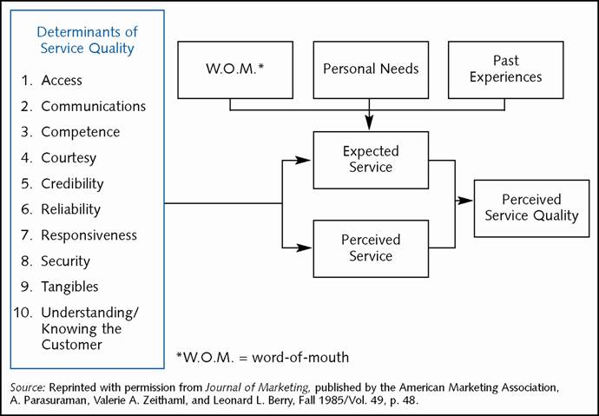
Determinants of Service Quality

Slide 15
Service Quality Design
Poka-Yoke: Fool proofing mechanisms
  Prevent inevitable mistakes from turning into defects
    Example: Repeating back order at Starbucks before giving you a cup of coffee
  Conceived of by Shigeo Shingo, “Mr. Improvement”

Slide 16
Quality: Profit or Cost
Both!
Improving quality does require a company to incur costs
Return on quality storyline:
Improved
Service
Performance
Improved
Customer
Satisfaction
Improved
Customer
Retention
Increased
Market
Share
Increased
Profitability

Slide 17
Calculating Return on Quality
Determine customer needs from the service
Relate customer needs to internal business processes
Collect data on customers’ satisfaction with business processes
Relate customer satisfaction with various process and customer retention
Determine the shift in customer satisfaction with the firm or a
business process resulting from a quality improvement effort
Estimate the customer retention rate after the quality improvement effort
Estimate the market share impact corresponding to the new retention rate
Determine the profit impact resulting from the change in market share,
plus any cost savings, minus the cost of the quality improvement effort

Slide 18
Other Quality-Related
Sources of Profits
Cost reductions due to increased efficiency
Attraction of new customers resulting from positive word-of-mouth
The ability to charge higher prices

Slide 19
Costs of Quality
Prevention of problems
Inspection and appraisal to monitor ongoing quality
The cost to rework a defective product before it is delivered to a customer
The cost to repair/replace a defected product after it reaches the customer

Slide 20
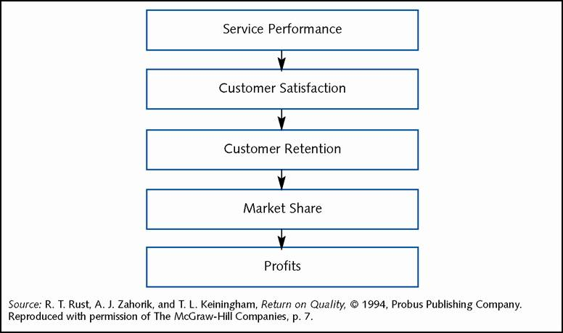
Chain of Events from
Quality to Profits

Slide 21
Implementing Quality Service
Design fail-safe attributes into services
Service guarantees and refunds
  Unconditional
  Easy to understand and communicate
  Meaningful
  Easy to invoke
  Easy to collect

Slide 22
Service Recovery
Measure the costs
Break the silence and listen closely for complaints
Anticipate the needs for recovery
Act fast
Train employees
Empower the front line
Close the loop

Slide 23
The Cost of Quality
In the long run, the most important single factor affecting a business unit’s performance is the quality of its products and services relative to those of competitors
  Inferior quality: 8% ROS, 16% ROI
  Superior quality: 12% ROS, 32% ROI

Slide 24
Chapter Summary
Service quality is often defined as the satisfaction of expectations based on a customer’s need for service.
Service design can greatly affect the quality of a service
  Poka yoke devices can often block mistakes before they become service defects
Implementing quality service can include offering service guarantees
  Recovery is another critical part of delivery quality

